Slide 1



Engineering Electromagnetics 工程电磁场
Youwei Jia 嘉有为

Slide 2

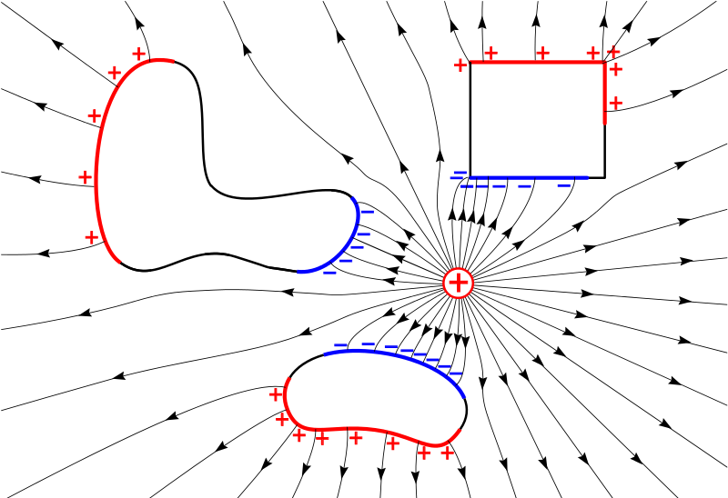
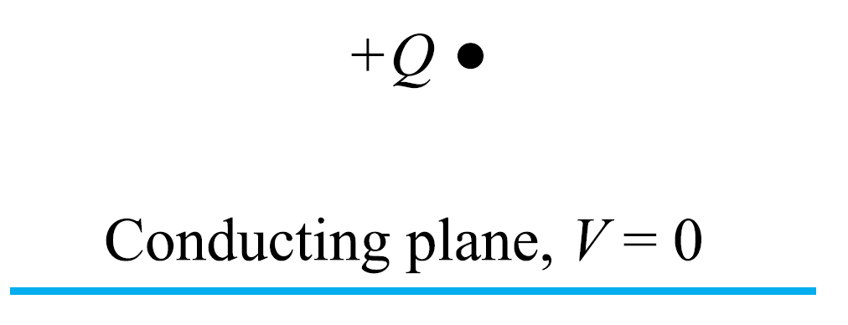
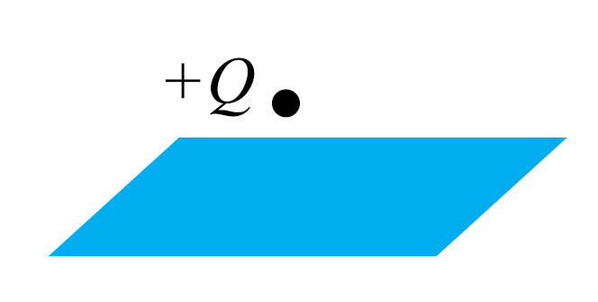
9: Conductors & Dielectrics
Method of Images 镜像法
Think about the effect of metal conductors on the electric field built by the point charge in free space. Why are the streamlines distorted? How can we evaluate such kind of distortion? Can we analytically solve the distorted field?
Unfortunately, in most cases, we are not able to derive analytical solution. However, sometimes we can!
23

Slide 3


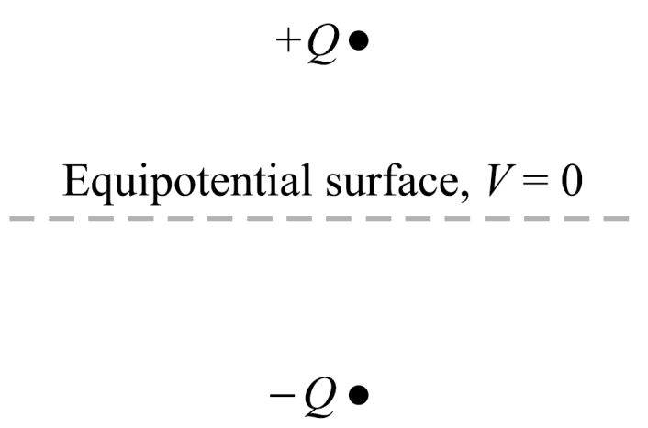
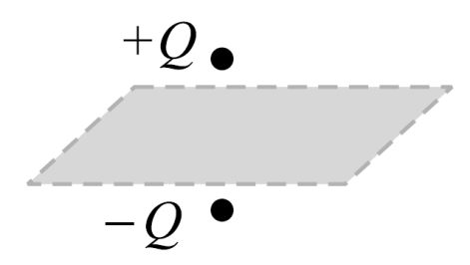
9: Conductors & Dielectrics
Method of Images 镜像法
The Theorem of Uniqueness 唯一性定理 states that if we are given a configuration of charges and boundary conditions, there will exist only one potential and electric field solution.
So the boundary conditions and charges are identical in the upper half spaces of both configurations (not in the lower half).
24

Slide 4


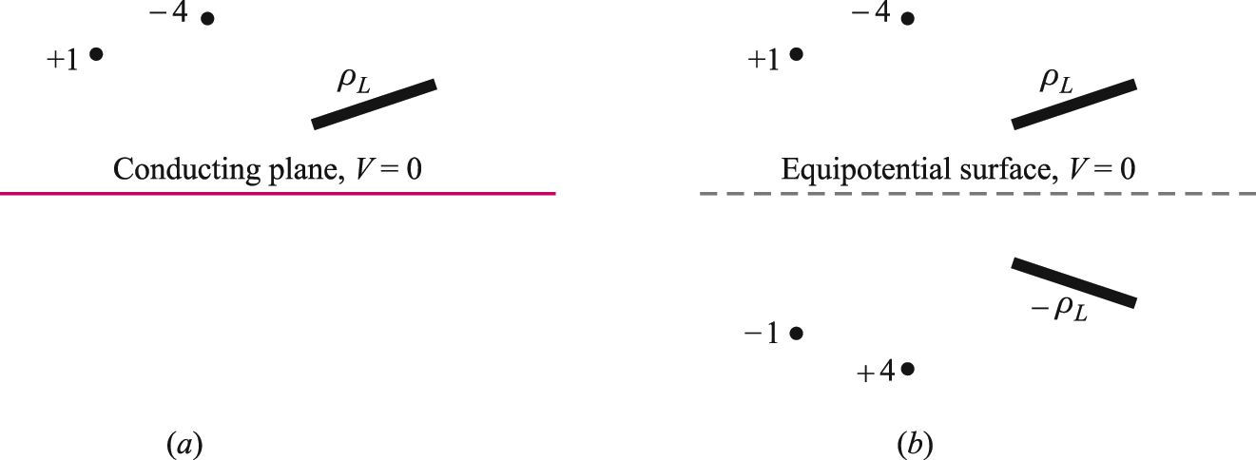
9: Conductors & Dielectrics
Method of Images 镜像法
In effect, the positive point charge images across the conducting plane, allowing the conductor to be replaced by the image. The field and potential distribution in the upper half space is now found much more easily!
25

Slide 5
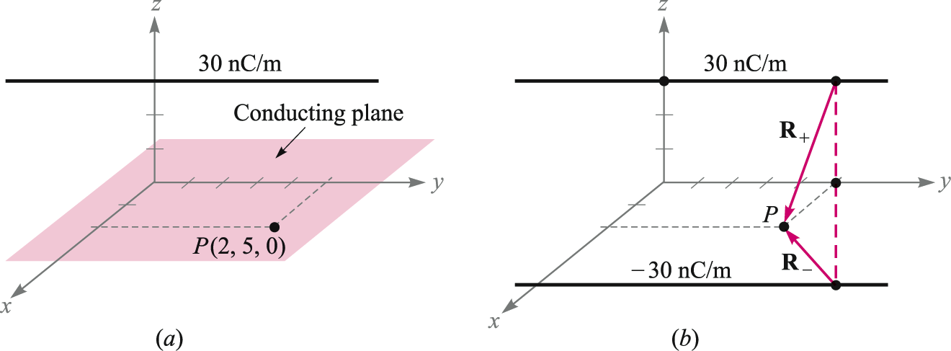
9: Conductors & Dielectrics
Example
In this case, we are to find the surface charge density on the conducting plane at the point (2,5,0). A 30-nC line charge lies parallel to the y axis at z = 3.
The first step is to replace the conducting plane by a line charge of -30 nC at z = -3.
26

Slide 6
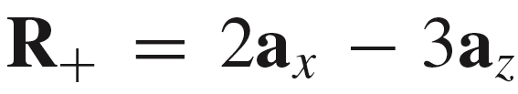

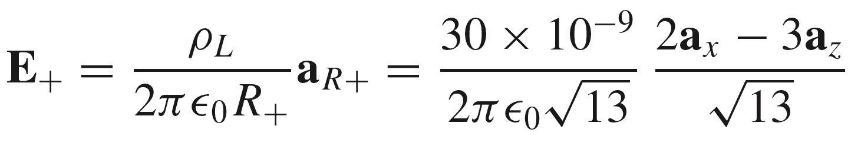
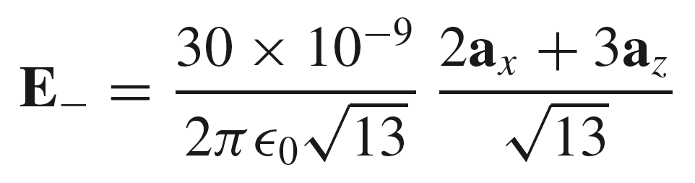
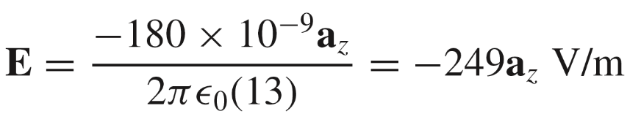
9: Conductors & Dielectrics
Example (Cont’d)
In this case, we are to find the surface charge density on the conducting plane at the point (2,5,0). A 30-nC line charge lies parallel to the y axis at z = 3.
Referring to the figure, we find:
Then
We now add the two fields to get:
27

Slide 7
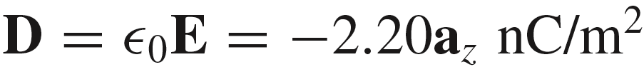
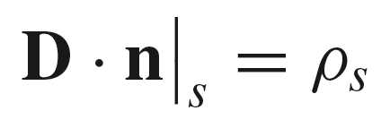
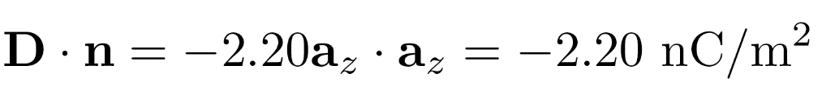
9: Conductors & Dielectrics
Example (Cont’d)
In this case, we are to find the surface charge density on the conducting plane at the point (2,5,0). A 30-nC line charge lies parallel to the y axis at z = 3.
We now have the electric field at point P:
Now
To find the charge density, use
n
where
n = a_{z}
Therefore
D
28

Slide 8
9: Conductors & Dielectrics
Dielectric Materials 电介质材料
Free space (vacuum): There is nothing out there!
Metal conductor: Copper, iron, aluminum…..,
1) Charge can exist only on the surface;
2) Electric field cannot exist in the interior;
3) Conductor is an equipotential;
4) Conductor-to-Free space boundary conditions.
Dielectric Materials (isolators): Air, Fiber, Glass, Paper, Quartz, Porcelain陶 瓷, Polyethylene聚乙烯
Q: What is the (electromagnetic) nature of dielectric materials? And Why?
29

Slide 9
9: Conductors & Dielectrics
Dielectric Materials -Electric Dipole and Dipole Moment
In dielectric, charges are held in position (bound 束缚), and ideally there are no free charges that can move and form a current. Atoms and molecules may be polar 极化(having separated positive and negative charges) by the application of an electric field.
Consider such a polarized atom or molecule, which possesses a dipole moment, p, defined as the charge magnitude present, Q, times the positive and negative charge separation, d. Dipole moment is a vector that points from the negative to the positive charge.
Q
d
p = Qd a_{x}
Summary-Some new terms:
Free charges, bound charges(束缚电荷), polar molecule(极性分子), non-polar molecule(无极性分子), polarize(极化)……
30

Slide 10
9: Conductors & Dielectrics
Dielectric Materials -Model of a Dielectric
A dielectric can be modeled as an ensemble of bound charges in free space, associated with the atoms and molecules that make up the material. Some of these may have intrinsic dipole moments, others not. In some materials (such as liquids), dipole moments are in random directions.
31

Slide 11
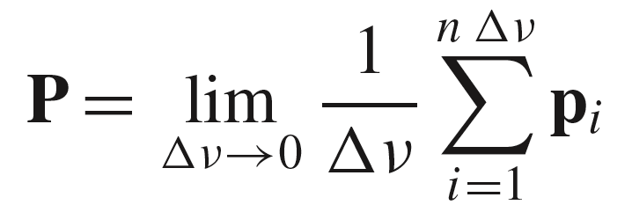
9: Conductors & Dielectrics
Dielectric Materials -Polarization Field
The number of dipoles is
expressed as a density, n
dipoles per unit volume.
The Polarization Field of the
medium is defined as:
v
Δ
Dipole moment per unit volume
Unit: [C/m²]
32

Slide 12
9: Conductors & Dielectrics
Polarization Field (with Electric Field Applied)
Introducing an electric field may increase the charge separation in each dipole, and possibly re-orient dipoles so that there is some aggregate alignment, as shown here. The effect is small, and is greatly exaggerated here!
E
The effect is to increase P.
if all dipoles are identical
= np
Note: There should be something to indicate the polarization degree of specific dielectric material.
33

Slide 13
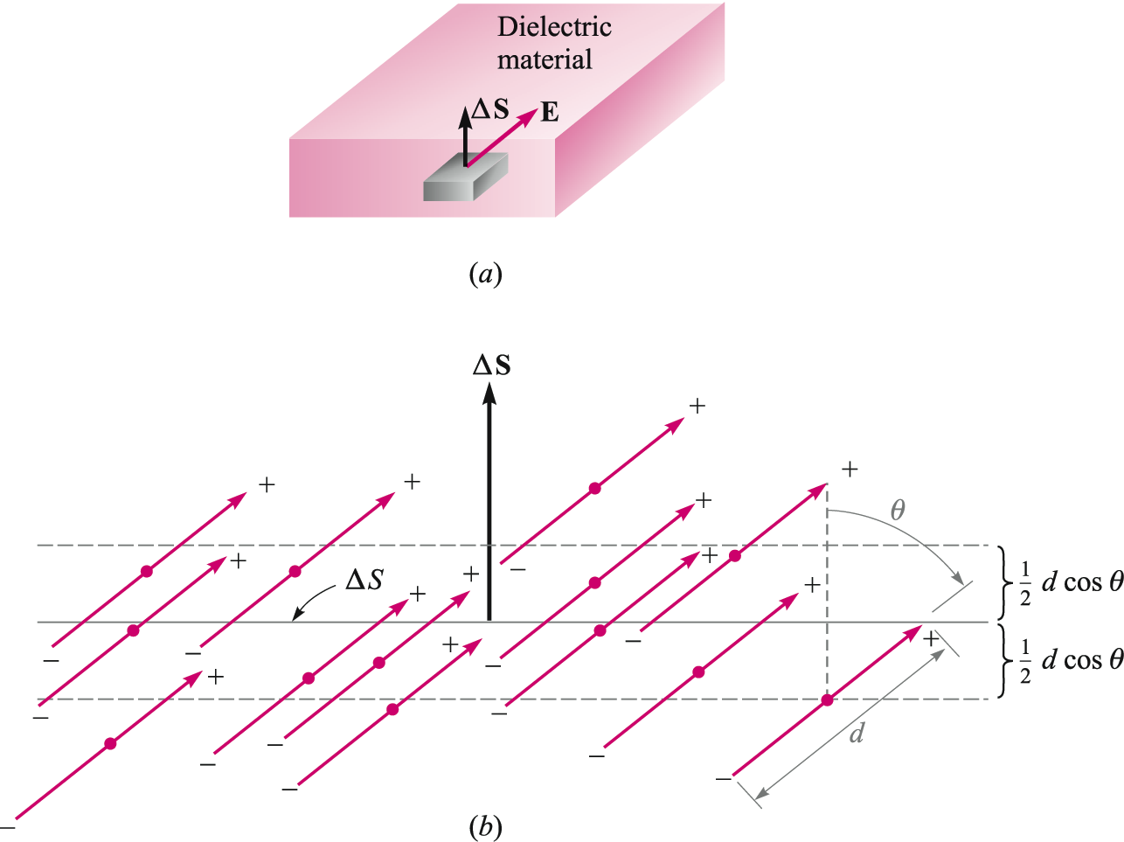
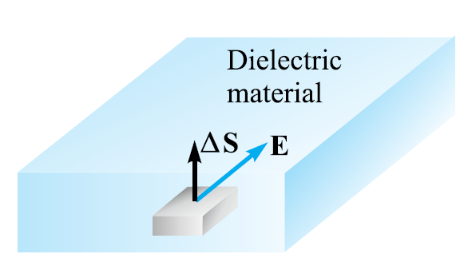
9: Conductors & Dielectrics
Migration of Bound Charge
Consider an electric field applied at an angle θ to a surface normal as shown. The resulting separation of bound charges (or re-orientation) leads to positive bound charge crossing upward through surface of area ΔS, while negative bound charge crosses downward through the surface.
Dipole centers (red dots) that lie within the range (1/2) d cosθ above or below
the surface will transfer charge across the surface.
E
34

Slide 14
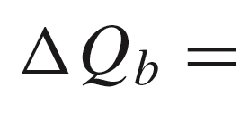
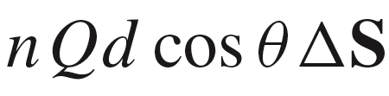
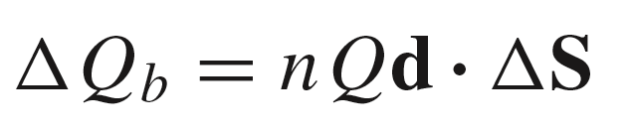
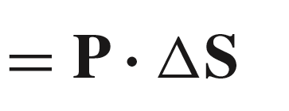
9: Conductors & Dielectrics
Migration of Bound Charge
The total bound charge that crosses the surface is given by:
ΔS
volume
E
P
35

Slide 15
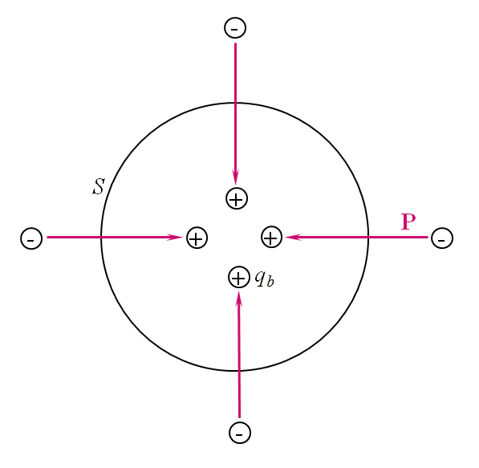
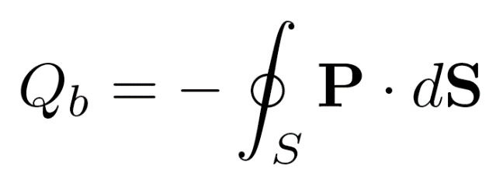
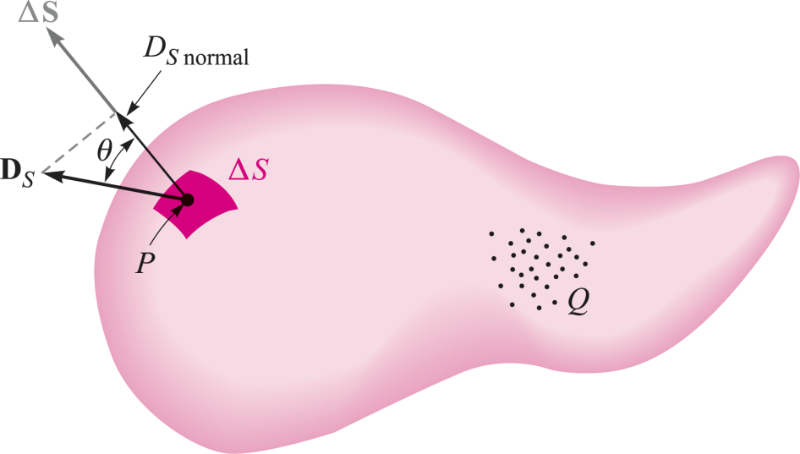
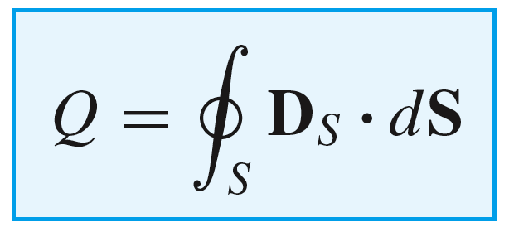
9: Conductors & Dielectrics
Polarization Flux Through a Closed Surface
The accumulation of positive bound charge within a closed
surface means that the polarization vector must be pointing
inward. Therefore:
Gauss’s Law in free space:
36

Slide 16
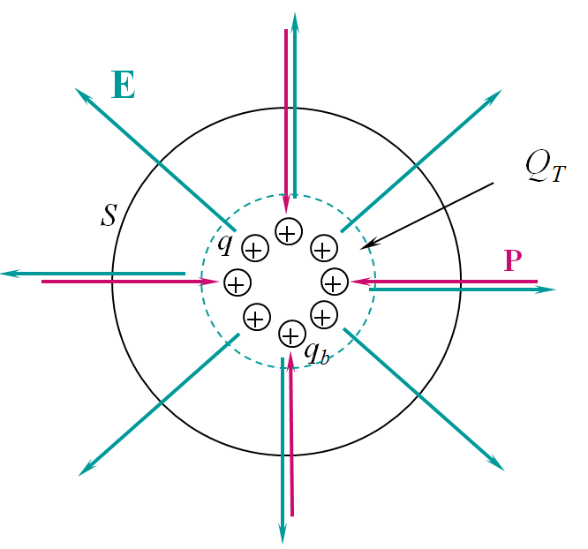
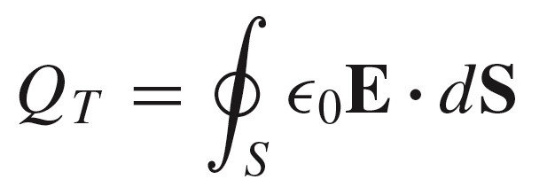
9: Conductors & Dielectrics
Polarization Flux Through a Closed Surface
Now consider the charge within the closed surface
consisting of bound charges, Q_{b} , and free charges, Q.
The total charge will be the sum of all bound and free
charges. We write Gauss’ Law in terms of the total
charge, Q_{T} as:
where
free charge
Q_{T} = Q_{b} + Q
bound charge
37

Slide 17

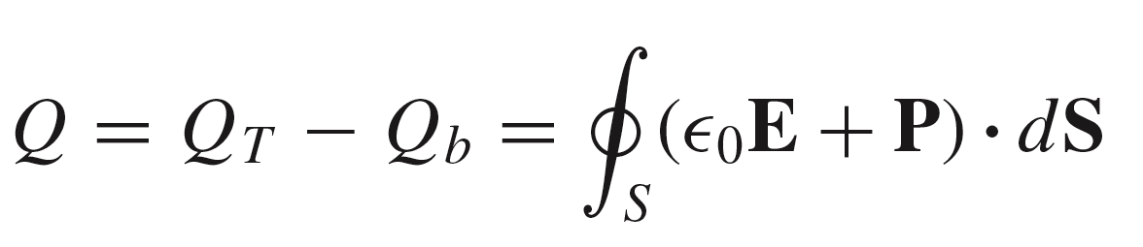
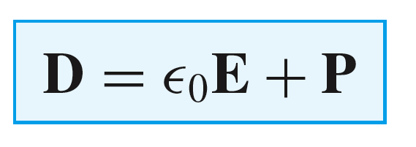
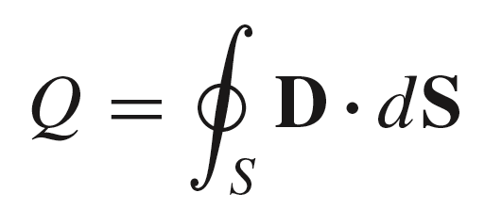
9: Conductors & Dielectrics
Polarization Flux Through a Closed Surface
We now have:
and
where
Q_{T} = Q_{b} + Q
combining these, we write:
we thus identify:
which we use in the familiar form
of Gauss’ Law:
38

Slide 18
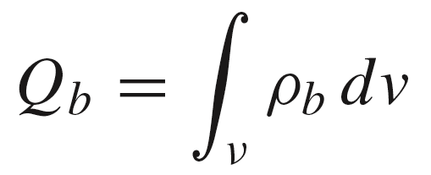
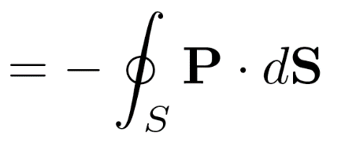
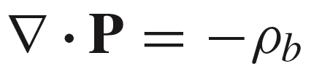
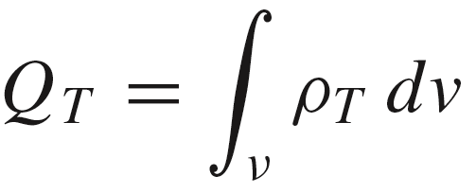
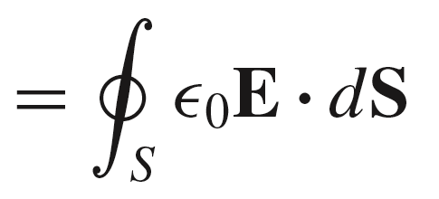
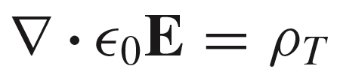
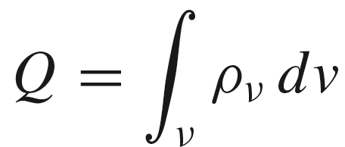
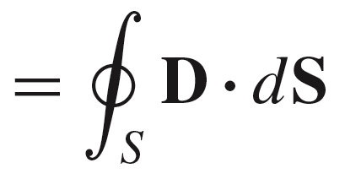
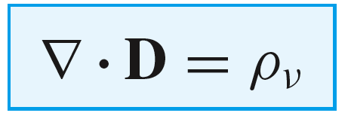
9: Conductors & Dielectrics
Charge Densities
Taking the previous results and using the divergence theorem, we find the point form expressions:
Bound Charge:
Total Charge:
Free Charge:
39

Slide 19
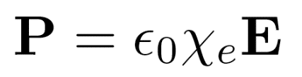
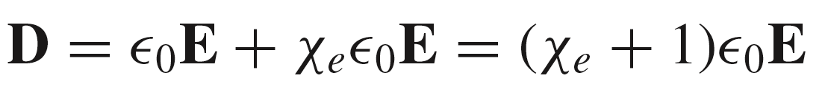
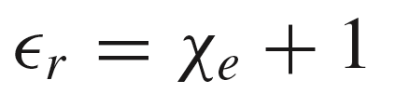
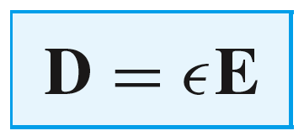
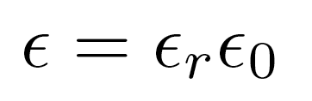
9: Conductors & Dielectrics
Electric Susceptibility电极化率 and the relative permittivity相对介电常数
A stronger electric field results in a larger polarization in the medium. In a linear medium, the relation between P and E is linear, and is given by:
where χ_{e} is the electric susceptibility (电极化率)of the medium.
We may now write:
where the relative permittivity （相对介电常数）is defined as:
Leading to the overall permittivity of the medium:
where
40

Slide 20
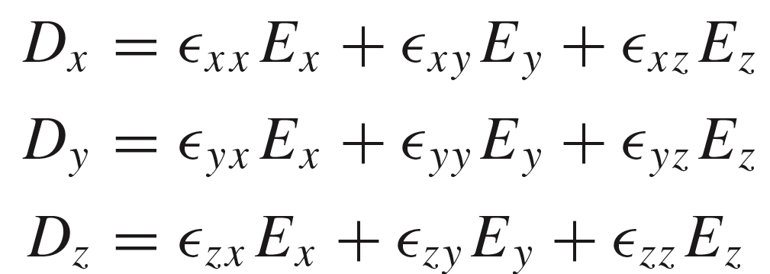
9: Conductors & Dielectrics
Isotropic各向同性 vs. Anisotropic各向异性 Media
In an isotropic medium, the dielectric constant is invariant with direction of the applied electric field.
This is not the case in an anisotropic medium (usually a crystal) in which the dielectric constant will vary as the electric field is rotated in certain directions. In this case, the electric flux density vector components must be evaluated separately through the dielectric tensor. The relation can be expressed in the form:
Note: 1) D and E (and P) are no longer parallel;
2) There may be hysteresis 滞后 between D and E.
41

Slide 21
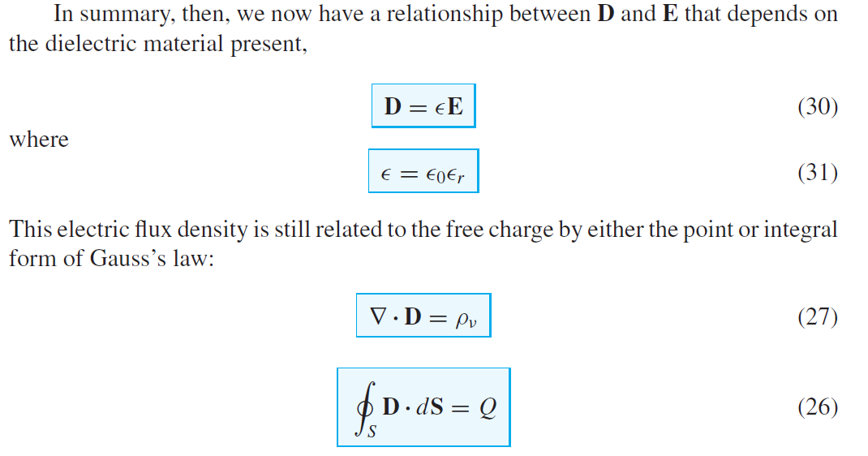
9: Conductors & Dielectrics
Summary
42

Slide 22
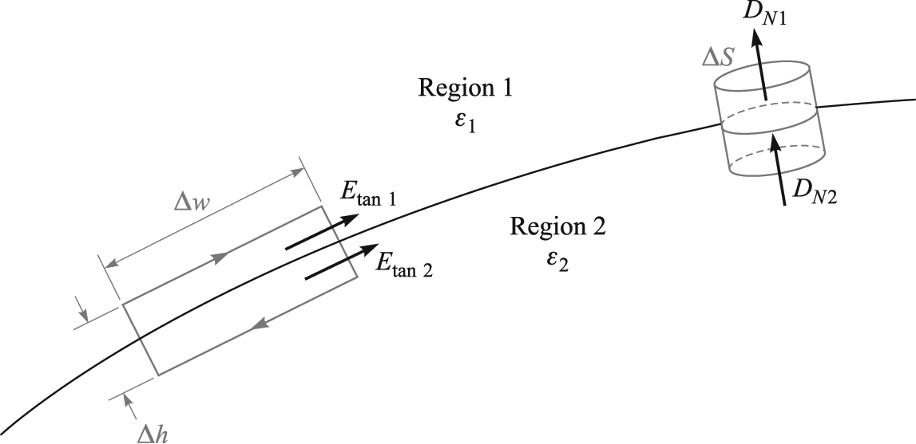
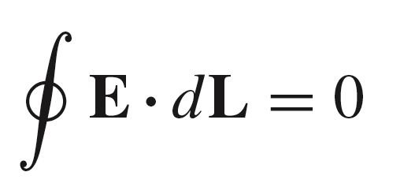
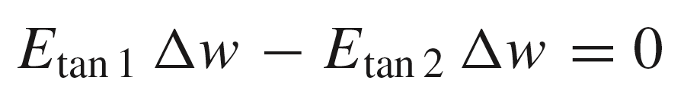
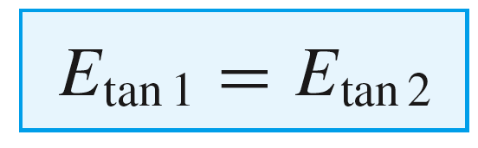



9: Conductors & Dielectrics
Boundary Condition for Tangential Electric Field
We use the fact that E is conservative:
n
Therefore:
Region 1
ε₁
Leading to:
Region 2
More formally:
ε₂
44

Slide 23




9: Conductors & Dielectrics
Boundary Condition for Normal Electric Flux Density
We apply Gauss’ Law to the cylindrical volume shown here, in which cylinder height is allowed to approach zero, and there is charge density ρ_{s} on the surface:
n
Region 1
ε₁
ρ_{s}
Region 2
ε₂
The electric flux enters and exits only through the bottom and top surfaces, respectively.
From which:
More formally:
and if the charge density is zero:
45

Slide 24

9: Conductors & Dielectrics
Example
We wish to find the relation between the angles θ₁ and θ₂, assuming no charge density on the surface.
46

Slide 25




9: Conductors & Dielectrics
Example
We wish to find the relation between the angles θ₁ and θ₂, assuming no charge density on the surface.
The normal components of D will be continuous across
the boundary, so that:
Then, with tangential E continuous across the
boundary, it follows that:
Now, taking the ratio of the two underlined
equations, we finally obtain:
or…
46

Slide 26



HW-5
47

